Slide 1
App in a Day Microsoft Power Platform
Power Apps
Power Automate
Microsoft Dataverse
August 2022

Slide 2
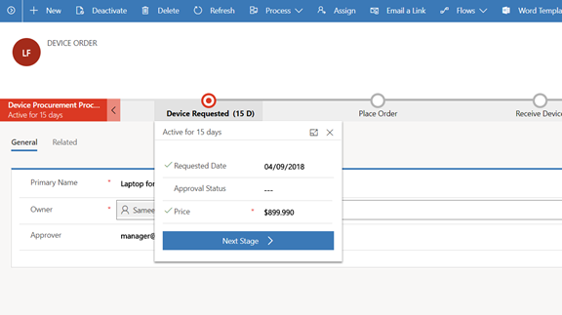
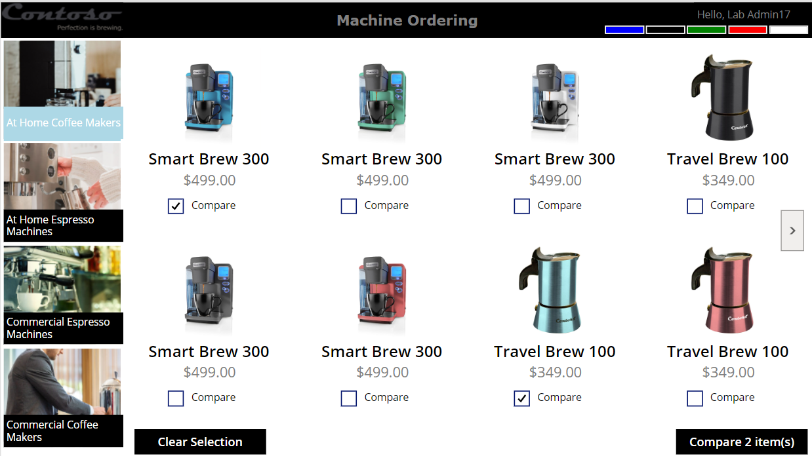
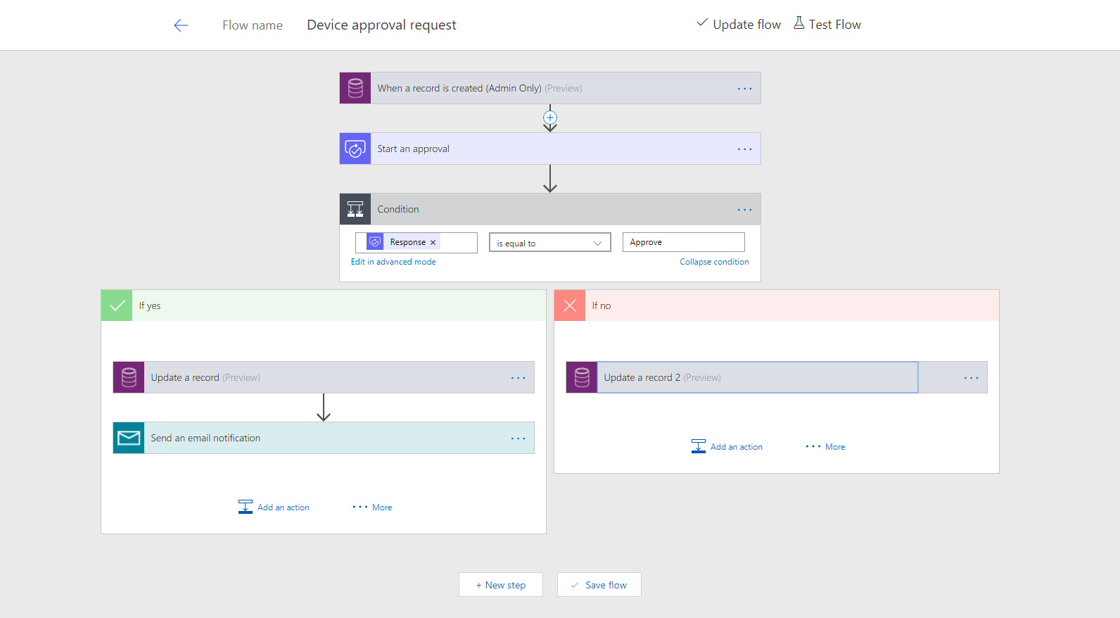
Business scenario
Imagine an organization where every few years the employees request an updated coffee machine for their employee break room
We will streamline the device order, procurement and approval process and view aggregate reports
The employee-facing device ordering app needs to run in a web browser and on mobile devices
Notes:
The apps and automation you will build today will support this process

Slide 3
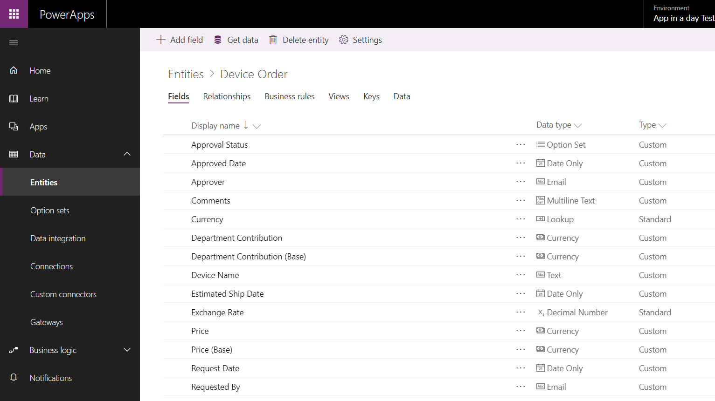
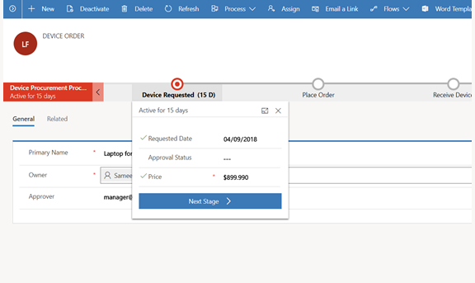
Lab objectives
Build a Power Apps Canvas App for employee facing device ordering experience
Use Dataverse to store the device orders in the cloud
Build a Power Apps Model-driven app to complete the procurement process
Use Power Automate to build an approval workflow for device approval
Notes:
You will go thru the complete story with making apps and automation to support each other.

Slide 4

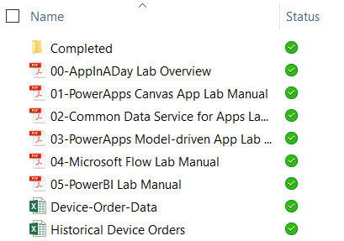
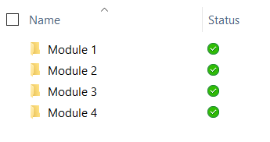
Lab content
Package: http://aka.ms/appinaday
Unzip the package on your local machine
Follow instructions: “00-AppinaDay Lab Overview.pdf”
Contains 4 modules with a lab doc for each
01-Power Apps Canvas App
02-Dataverse
03-Power Apps Model-driven App
04- Power Automate
Lab docs:
Completed modules:
Completed Modules
The \Completed folder contains solution packages that you can import
e.g. To work on Module 4 without completing previous modules -> see \Completed\Module3
Notes:
We will start with the beginning and work through each module. However, if for some reason you need to start with a later module, follow the directions given in the completed modules folder.

Slide 5
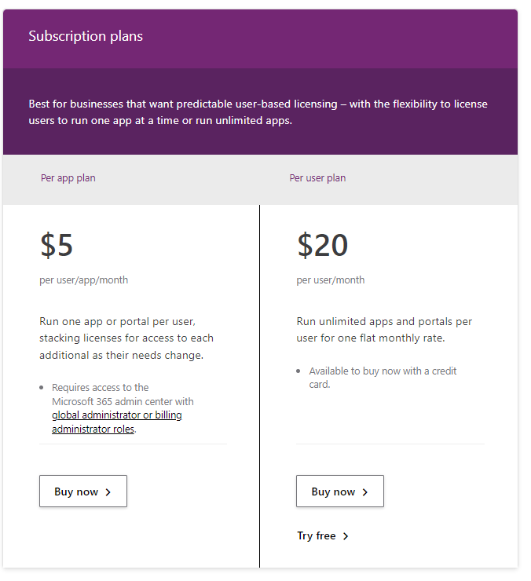
Pre-requisites
Valid Power Apps license:
Dataverse usage requires a Power Apps license
Visit https://powerapps.microsoft.com/pricing/ and click Free Trial
If you are unable to acquire a trial license: Ask the instructor for a trial user account that you may use for this session OR Create your own Office 365 trial tenant
Power Apps authoring environment:
Launch https://make.powerapps.com using any modern browser
Power Apps mobile apps (Optional):
PowerApps – iOS : https://aka.ms/PowerAppsiOS PowerApps – Android : https://aka.ms/PowerAppsAndroid
Notes:
****Many students will have environments provided for them by their trainer, if that is the case, you can not deliver this slide. ****

Slide 6
Provision environment and Dataverse
This lab requires a new Power Apps environment and database that was provisioned for this class
Go to the Power Apps Admin center – https://aka.ms/ppac
Select +New environment, fill out the form using a Trial Environment, and select Create Environment
Select the Create database option
Fill out the form, check the box to include sample apps and data and select Create my database
Your new environment will be added to the list of environments
IMPORTANT: The database has not yet been provisioned
Select the environment you just created
Wait for the “Provisioning database…” message to go away
You may need to refresh the screen every couple of minutes
Once the provisioning is complete, then proceed to create apps in the environment
Notes:
****Many students will have environments provided for them by their trainer, if that is the case, you can not deliver this slide. ****

Slide 7
Lab overview
Canvas App
Dataverse
Model-driven
App
Power Automate
Notes:
This slide is intended to set the stage for all of the lab content and morphs into the following slide in show mode
The first lab is centered around Accessing & Preparing the data
Then we’ll cover Data modeling and exploration
After lunch, we’ll look at the different ways we can visualize the data using PowerBI on different platforms
Lastly, in labs 4 and 5 we’ll review publishing, accessing, and building & sharing dashboards

Slide 8
Hands-on-lab 1
Module 1: Power Apps Canvas App
Notes:
Now a little bit about the first lab

Slide 9
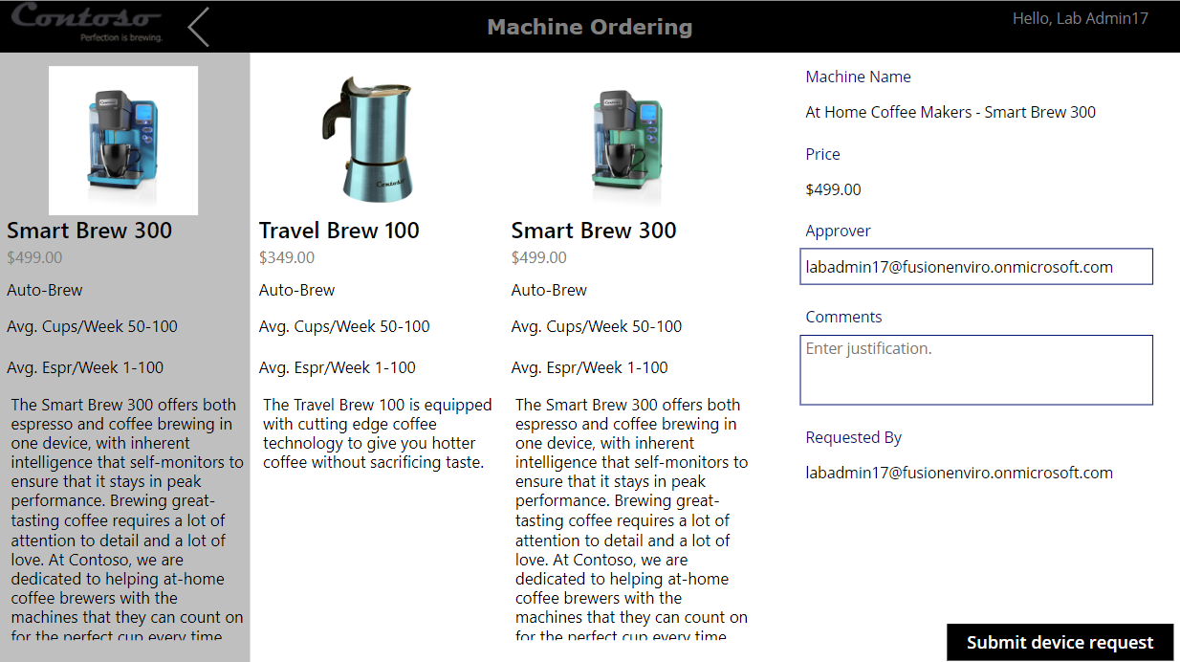
Module 1:Learning objectives
Canvas App
Dataverse
Model- driven
App
Power Automate
Sign-in and create a new canvas app
Connect to data sources
Filter data
Work with multiple screens and navigation
Customize the user experience – galleries and controls
Notes:
Talk about this from your own experiences, share what YOU learned when you did the labs.

Slide 10
Hands-on-lab 2
Module 2: Dataverse

Slide 11
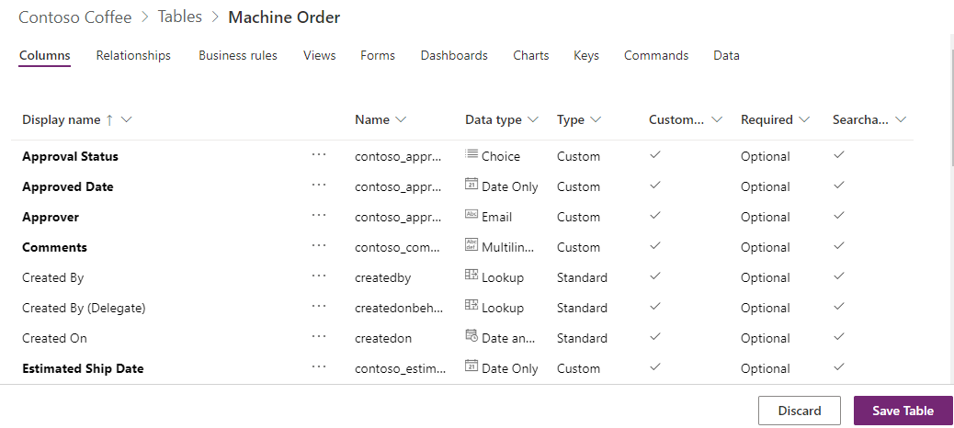
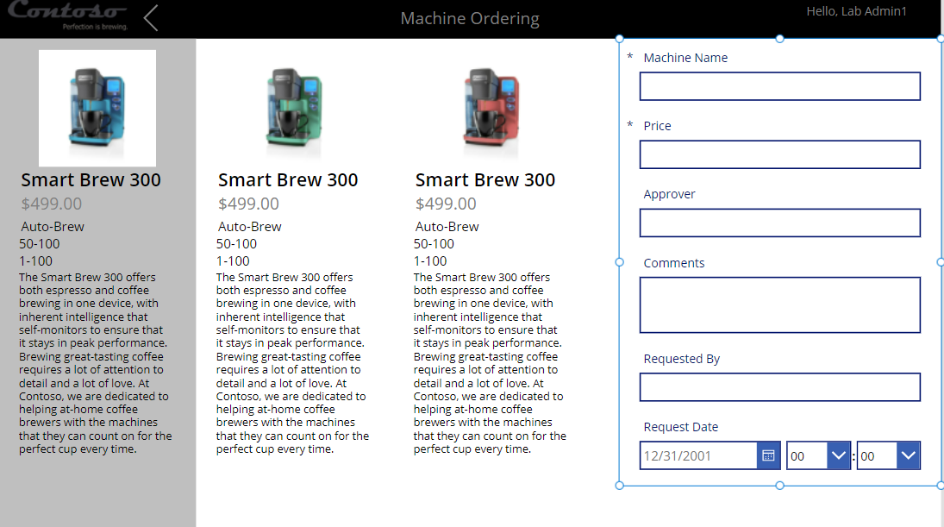
Module 2: Learning objectives
Canvas App
Dataverse
Model- driven
App
Power Automate
Work with tables
Get familiar with standard tables
Create a custom table
Customize table columns and choices
Create calculated fields
Work with canvas app
Use the canvas app form control to save data
Use the Office 365 connector to get user’s manager info
Configure canvas app settings
Save and share a canvas app
Run a canvas app on a mobile device
Notes:
In this lab you will be working on the foundation you need for a more robust canvas app that you started in the prior lab

Slide 12
Hands-on-lab 3
Module 3: Power Apps Model-driven App

Slide 13
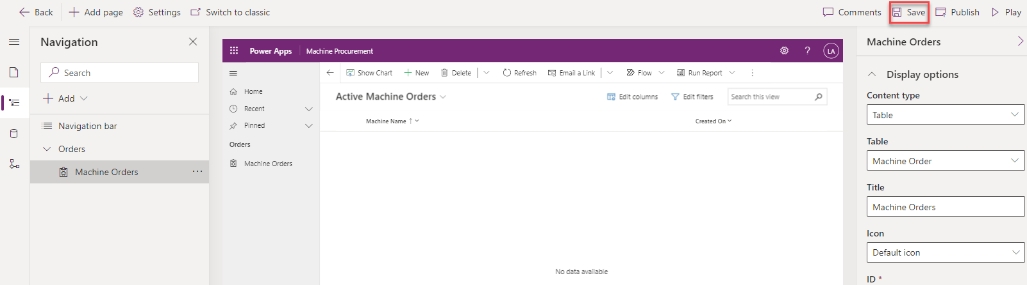
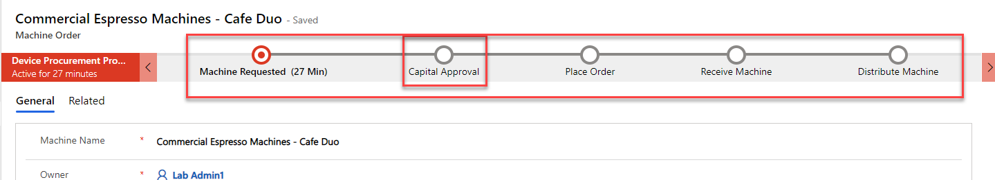
Module 3: Learning objectives
Canvas App
Dataverse
Model- driven
App
Power Automate
Create a standalone model-driven app
Customize forms for the model-driven app
Create a Business Process Flow
Notes:
This lab will continue our story as we build supporting elements for our ordering.

Slide 14
Hands-on-lab 4
Module 4: Power Automate

Slide 15
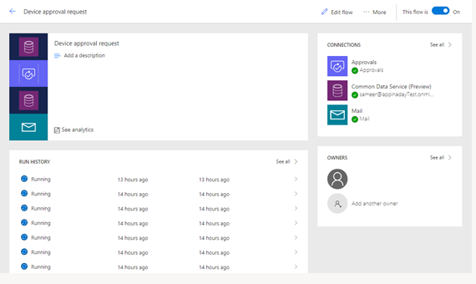
Module 4: Learning objectives
Canvas App
Common Data Service
Model- driven
App
Power Automate
Trigger a flow when a new record is created
Send an approval request
Conditional branching based on the approval response
Send email notifications
Update the record with the approval status and the approver’s comments
Use the approval center on web and mobile
Check the status of flow runs
Notes:
Let’s add some automation to our story

Slide 16
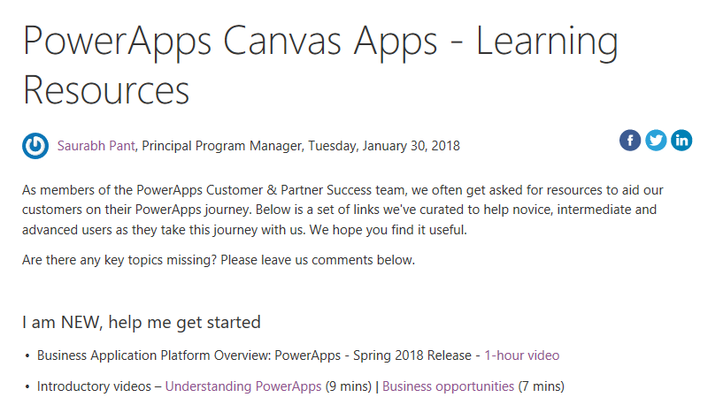
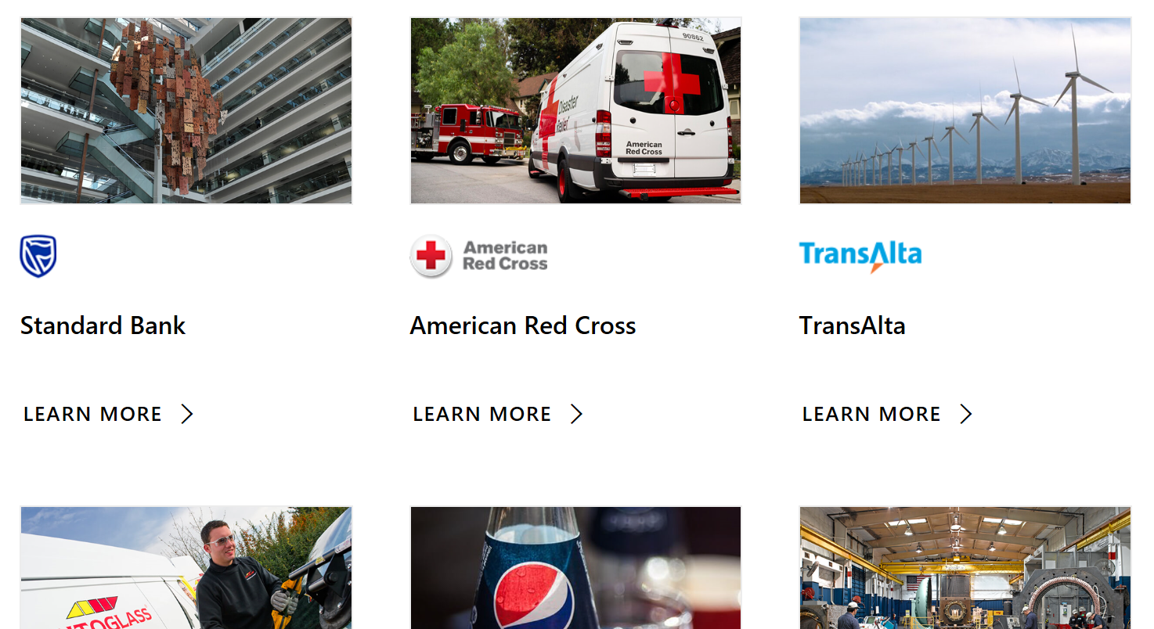
Learning resources and Customer stories
Learning resources
http://aka.ms/powerapps-resources
https://flow.microsoft.com/en-us/blog
Customer stories
http://aka.ms/PowerAppsStories
http://aka.ms/GJPepsiVideo
http://aka.ms/ArrivaVideo
http://aka.ms/HeathrowVideo

Slide 17
Closing Slide

